Slide 1
UPPER SIXTH ARTS
GEOGRAPHY
Practical Work 1
Techniques of Mapping Population Distribution and Density
Notes:
Good morning, class, and welcome to our geography lesson. I am your geography teacher, Mr Kamdem. Today we are starting Practical Work 1: Techniques of Mapping Population Distribution and Density.

Slide 2
CLASS INFO
Class, Chapter and Duration
Class | Upper Sixth Arts
Chapter | Module 4: Understanding and managing population dynamics across the world in general and Cameroon in particular
Duration | 2 periods (2 × 50 minutes)
Notes:
This lesson is for Upper Sixth Arts. It belongs to Module 4: Understanding and managing population dynamics across the world in general and Cameroon in particular. We shall need 2 periods to cover it.

Slide 3
IDENTIFICATION
Lesson Identification
Topic | Population Numbers
Sub-topic | Population Density and Distribution
Lesson | Practical Work 1: Techniques of Mapping Population Distribution and Density
Notions / Concepts | Choropleth map, isopleth map, dot map, proportional symbols, Lorenz curve, population density lapse rate.
Syllabus focus | Techniques of mapping distribution and density (choropleth, isopleth, dot map, proportional symbols); other methods showing unevenness (Lorenz curve, density lapse rate); assessment of these methods.
Competence | Learners are able to choose, draw and read the main maps and graphs of population distribution and density.
Notes:
Our topic is Population Numbers, and the sub-topic is Population Density and Distribution. The key notions we shall use today are: choropleth map, isopleth map, dot map, proportional symbols, Lorenz curve, population density lapse rate. At the end, you should be able to do this: learners are able to choose, draw and read the main maps and graphs of population distribution and density.

Slide 4

HOMEWORK CORRECTION
Correction of the Homework
Question (Lesson 2: Population Distribution and Density):
Name two types of maps that show population density.
Notes:
Before we start the new lesson, let us correct the homework I gave you at the end of Lesson 2: Population Distribution and Density. The question was: Name two types of maps that show population density. Take out your exercise books.

Slide 5
HOMEWORK CORRECTION
Correction: Possible Answer
The choropleth map and the dot map (also the isopleth map and the proportional symbol map).
Notes:
Here is a good answer. The choropleth map and the dot map (also the isopleth map and the proportional symbol map). Compare it with your own answer and correct your work in red.

Slide 6
LESSON PLAN
Lesson Plan
Correction of the homework
Objectives and recall
Real-life situation and action to take
Learning activities
Board summary
Evaluation, remediation and homework
Notes:
Here is the plan of our lesson today. First, we shall correct the homework. Then we shall look at the objectives and recall what you already know. After that, we shall study a situation from real life and the action to take, and do the learning activities. Finally, we shall copy the board summary, do the evaluation and the remediation, and I will give you the homework.

Slide 7
OBJECTIVES
Objectives
By the end of this lesson, you should be able to:
Describe the choropleth, isopleth, dot and proportional symbol maps.
Explain how the Lorenz curve and the density lapse rate show unevenness.
Notes:
Take your time to copy this part; we will continue together.

Slide 8
OBJECTIVES
Objectives (continued)
Assess the advantages and disadvantages of each technique.
Notes:
By the end of this lesson, you should be able to do three things. Number 1: describe the choropleth, isopleth, dot and proportional symbol maps. Number 2: explain how the Lorenz curve and the density lapse rate show unevenness. Number 3: assess the advantages and disadvantages of each technique.

Slide 9
PREVIOUS KNOWLEDGE
Previous Knowledge
Population density is the number of people per km².
The Littoral Region is denser than the East Region.
A map key explains the colours and symbols of a map.
Notes:
Let us first remember what you already know. Population density is the number of people per km². The Littoral Region is denser than the East Region. A map key explains the colours and symbols of a map. Keep this in mind, because we shall build on it today.

Slide 10
REAL-LIFE SITUATION
Situation in Real Life
For the regional council, a student must show on one map that the Littoral and the West are crowded while the East is almost empty.
He also wants to show that most people of Cameroon live on a small part of the land.
Notes:
Take your time to copy this part; we will continue together.

Slide 11
REAL-LIFE SITUATION
Situation in Real Life (continued)
He asks his teacher: "Which maps and graphs should I use, and what are their strengths and weaknesses?"
Notes:
Listen carefully to this situation from real life. For the regional council, a student must show on one map that the Littoral and the West are crowded while the East is almost empty. He also wants to show that most people of Cameroon live on a small part of the land. He asks his teacher: "Which maps and graphs should I use, and what are their strengths and weaknesses?" Think about it, because I am going to ask you some questions.

Slide 12
REAL-LIFE SITUATION
Situation: Question 1
What is the problem in the situation?
Notes:
Question 1: What is the problem in the situation? Think for a moment, then raise your hand to answer.

Slide 13
REAL-LIFE SITUATION
Answer
The student does not know which techniques to use to map population distribution and density.
Notes:
Good. The student does not know which techniques to use to map population distribution and density.

Slide 14
REAL-LIFE SITUATION
Situation: Question 2
Which map uses shades of one colour by region?
Notes:
Question 2: Which map uses shades of one colour by region? Think for a moment, then raise your hand to answer.

Slide 15
REAL-LIFE SITUATION
Answer
The choropleth map.
Notes:
Good. The choropleth map.

Slide 16
REAL-LIFE SITUATION
Situation: Question 3
Which graph shows that people live on a small part of the land?
Notes:
Question 3: Which graph shows that people live on a small part of the land? Think for a moment, then raise your hand to answer.

Slide 17
REAL-LIFE SITUATION
Possible Answer
The Lorenz curve.
Notes:
Good. The Lorenz curve.

Slide 18
ACTION TO TAKE
Action to Take
Choose the right map or graph for each set of population data and always add a title, a key and a source.
Notes:
From this situation, the action we are working towards in this lesson is the following: choose the right map or graph for each set of population data and always add a title, a key and a source.

Slide 19
JUSTIFICATION
Justification of the Lesson
This practical work helps us to present population data clearly on maps and graphs, a skill used in examinations and in planning.
Notes:
Why is this lesson important for you? This practical work helps us to present population data clearly on maps and graphs, a skill used in examinations and in planning.

Slide 20

1. CHOROPLETH MAP
Activity 1
A choropleth map of Cameroon.
Notes:
Activity 1. Look carefully at this diagram: a choropleth map of Cameroon. Observe every detail before I ask the question.

Slide 21
1. CHOROPLETH MAP
Activity 1: Question
What do the darker shades show on this map?
Notes:
Here is the question for Activity 1: What do the darker shades show on this map? Take one minute to think and write your answer in your rough notebook.

Slide 22
1. CHOROPLETH MAP
Activity 1: Answer
Higher population densities.
Notes:
Let us check the answer together. Higher population densities.

Slide 23
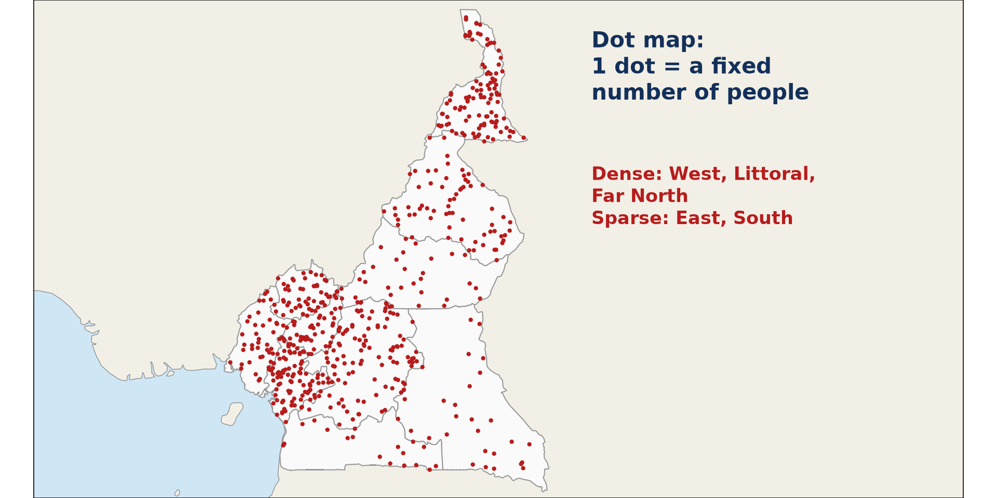
1. DOT MAP
Activity 2
A dot map of Cameroon.
Notes:
Activity 2. Look carefully at this diagram: a dot map of Cameroon. Observe every detail before I ask the question.

Slide 24
1. DOT MAP
Activity 2: Question
What does each dot represent on a dot map?
Notes:
Here is the question for Activity 2: What does each dot represent on a dot map? Take one minute to think and write your answer in your rough notebook.

Slide 25
1. DOT MAP
Activity 2: Answer
A fixed number of people, for example 10,000.
Notes:
Let us check the answer together. A fixed number of people, for example 10,000.

Slide 26
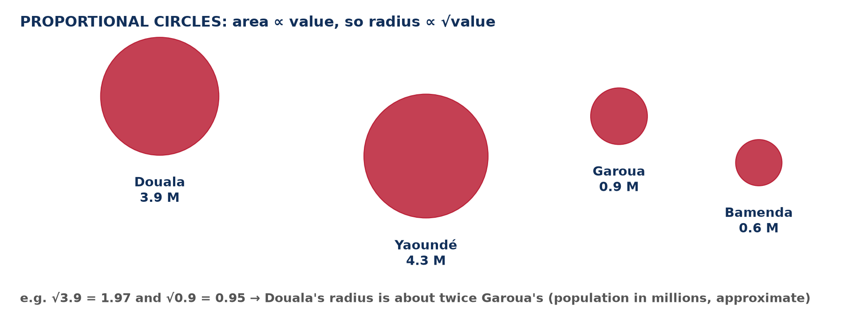
1. PROPORTIONAL SYMBOLS
Activity 3
Proportional circles.
Notes:
Activity 3. Look carefully at this diagram: proportional circles. Observe every detail before I ask the question.

Slide 27
1. PROPORTIONAL SYMBOLS
Activity 3: Question
Why is the circle of Yaoundé bigger than that of Garoua?
Notes:
Here is the question for Activity 3: Why is the circle of Yaoundé bigger than that of Garoua? Take one minute to think and write your answer in your rough notebook.

Slide 28
1. PROPORTIONAL SYMBOLS
Activity 3: Answer
Its population is larger, and the area of the circle is proportional to the population.
Notes:
Let us check the answer together. Its population is larger, and the area of the circle is proportional to the population.

Slide 29
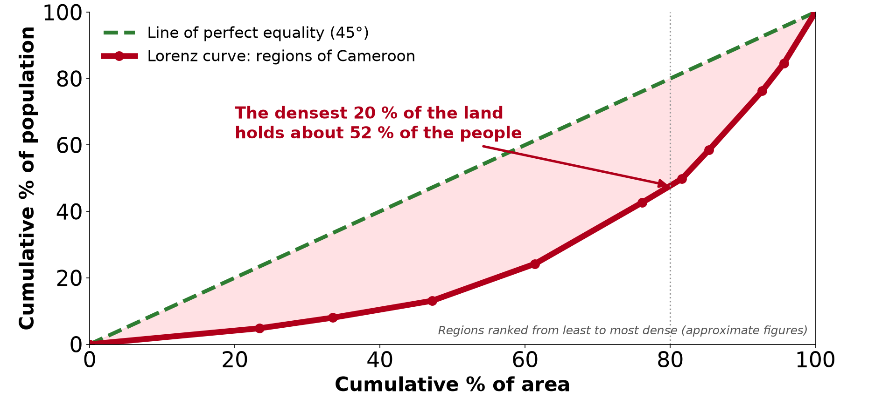
2. LORENZ CURVE
Activity 4
A Lorenz curve for Cameroon.
Notes:
Activity 4. Look carefully at this diagram: a Lorenz curve for Cameroon. Observe every detail before I ask the question.

Slide 30
2. LORENZ CURVE
Activity 4: Question
What does the gap between the curve and the diagonal show?
Notes:
Here is the question for Activity 4: What does the gap between the curve and the diagonal show? Take one minute to think and write your answer in your rough notebook.

Slide 31
2. LORENZ CURVE
Activity 4: Answer
The degree of unevenness: the bigger the gap, the more uneven the distribution.
Notes:
Let us check the answer together. The degree of unevenness: the bigger the gap, the more uneven the distribution.

Slide 32
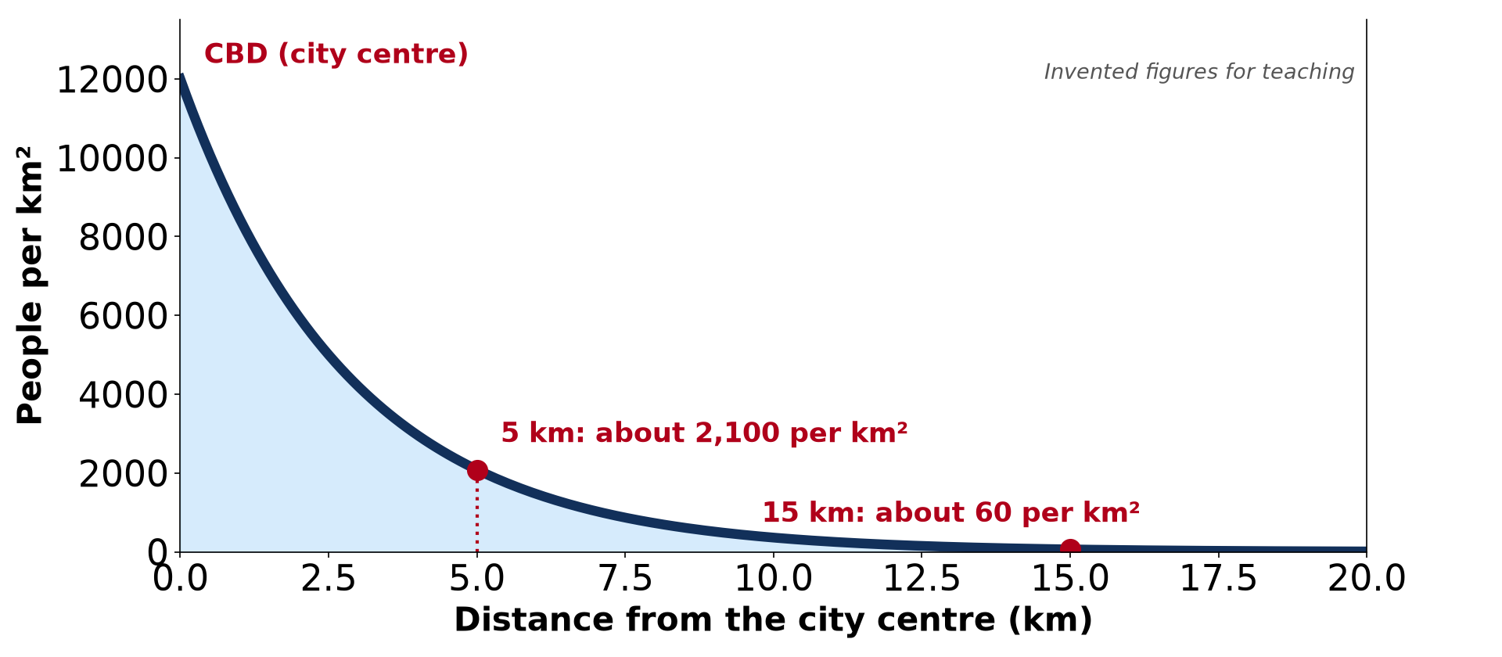
2. DENSITY LAPSE RATE
Activity 5
Density and distance from the city centre.
Notes:
Activity 5. Look carefully at this diagram: density and distance from the city centre. Observe every detail before I ask the question.

Slide 33
2. DENSITY LAPSE RATE
Activity 5: Question
How does density change as we move away from the city centre?
Notes:
Here is the question for Activity 5: How does density change as we move away from the city centre? Take one minute to think and write your answer in your rough notebook.

Slide 34
2. DENSITY LAPSE RATE
Activity 5: Answer
It falls steadily.
Notes:
Let us check the answer together. It falls steadily.

Slide 35
BOARD SUMMARY
Board Summary
Topic: Population Numbers
Sub-topic: Population Density and Distribution
Practical Work 1: Techniques of Mapping Population Distribution and Density
Notes:
Now we are going to copy the board summary. Write the title and the headings neatly in your notebooks. I will give you enough time for each slide, so do not rush.

Slide 36
BOARD SUMMARY
DEFINITIONS
The key terms of this lesson are defined as follows:
Choropleth map: It is a map that shows densities with shades of colour for each administrative area.
Isopleth map: It is a map with lines (isopleths) joining places of equal density.
Notes:
Let us copy the definitions. The key terms of this lesson are defined as follows. On this slide we have Choropleth map and Isopleth map. Write each point on a new line, with the key term first, and explain it in your own words when we revise. When you finish, we go to the next slide.

Slide 37
BOARD SUMMARY
DEFINITIONS (continued)
Dot map: It is a map on which each dot stands for a fixed number of people.
Lorenz curve: It is a graph comparing the cumulative percentage of population with the cumulative percentage of area to show unevenness.
Notes:
We continue with the definitions. On this slide we have Dot map and Lorenz curve. Write each point on a new line, with the key term first, and explain it in your own words when we revise. When you finish, we go to the next slide.

Slide 38
BOARD SUMMARY
DEFINITIONS (continued)
Density lapse rate: It is the rate at which population density falls with distance from a centre such as a city or the coast.
Notes:
We continue with the definitions. On this slide we have Density lapse rate. Write each point on a new line, with the key term first, and explain it in your own words when we revise.

Slide 39
BOARD SUMMARY
1. Techniques of Mapping Population Distribution and Density
Population is mapped with the following techniques:
Choropleth map: Each administrative area is shaded according to its density, with darker shades for higher densities. The map of the regions of Cameroon by density is an example.
Illustration: a choropleth map
Notes:
Let us copy Techniques of Mapping Population Distribution and Density. Population is mapped with the following techniques. Copy the point on Choropleth map on the left, then draw the diagram on the right: a choropleth map. Give it a title and label it clearly.

Slide 40
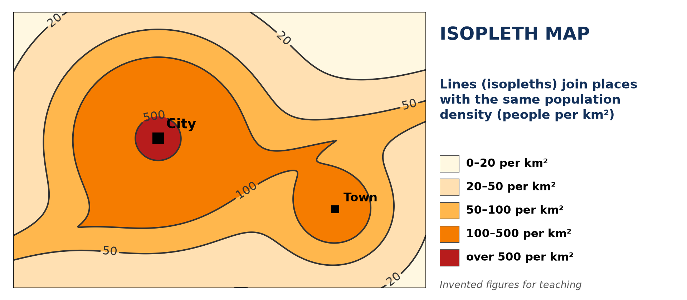
BOARD SUMMARY
1. Techniques of Mapping Population Distribution and Density
Isopleth map: Lines join places of equal density, like contour lines on a relief map. They show gradual changes across an area without following boundaries.
Illustration: an isopleth map
Notes:
Copy the point on Isopleth map on the left, then draw the diagram on the right: an isopleth map. Give it a title and label it clearly.

Slide 41
BOARD SUMMARY
1. Techniques of Mapping Population Distribution and Density
Dot map: Each dot represents a fixed number of people, for example 10,000, and is placed where they live. Clusters of dots show densely populated areas.
Illustration: a dot map
Notes:
Copy the point on Dot map on the left, then draw the diagram on the right: a dot map. Give it a title and label it clearly.

Slide 42
BOARD SUMMARY
1. Techniques of Mapping Population Distribution and Density
Proportional symbols: Circles or squares are drawn with an area proportional to the population of each town. The radius is therefore proportional to the square root of the population.
Illustration: proportional circles
Notes:
Copy the point on Proportional symbols on the left, then draw the diagram on the right: proportional circles. Give it a title and label it clearly.

Slide 43
BOARD SUMMARY
2. Showing Uneven Distribution
The unevenness of distribution is shown with the following methods:
Constructing the Lorenz curve: Areas are ranked from the least to the most dense, and their percentages of population and area are added up. The cumulative % of population is then plotted against the cumulative % of area.
Illustration: a Lorenz curve
Notes:
Let us copy Showing Uneven Distribution. The unevenness of distribution is shown with the following methods. Copy the point on Constructing the Lorenz curve on the left, then draw the diagram on the right: a Lorenz curve. Give it a title and label it clearly.

Slide 44
BOARD SUMMARY
2. Showing Uneven Distribution
Reading the Lorenz curve: The diagonal line shows a perfectly even distribution. The further the curve lies from the diagonal, the more uneven the distribution.
Notes:
We continue with Showing Uneven Distribution. Copy the point on Reading the Lorenz curve: write the key term first, then its explanation.

Slide 45
BOARD SUMMARY
2. Showing Uneven Distribution
The density lapse rate: Density is plotted against distance from a city centre or from the coast, and it usually falls quickly outwards. In Yaoundé, for example, density is very high near the centre and falls towards the outskirts.
Illustration: a density lapse rate
Notes:
Copy the point on The density lapse rate on the left, then draw the diagram on the right: a density lapse rate. Give it a title and label it clearly.

Slide 46
BOARD SUMMARY
3. Assessment of the Techniques
The techniques have the following advantages and disadvantages:
Choropleth map: It is easy to draw and read and allows areas to be compared quickly. However, it hides differences inside each area and depends on administrative boundaries.
Notes:
Let us copy Assessment of the Techniques. The techniques have the following advantages and disadvantages. Copy the point on Choropleth map: write the key term first, then its explanation.

Slide 47
BOARD SUMMARY
3. Assessment of the Techniques
Isopleth map: It shows gradual changes across a region and is not limited by boundaries. However, it needs many data points and is harder to draw and read.
Notes:
We continue with Assessment of the Techniques. Copy the point on Isopleth map: write the key term first, then its explanation.

Slide 48
BOARD SUMMARY
3. Assessment of the Techniques
Dot map and proportional symbols: Dot maps show the real pattern and clusters of people, and proportional symbols are easy to compare at a glance. However, dots merge and symbols overlap in crowded areas, so exact numbers are hard to read.
Notes:
We continue with Assessment of the Techniques. Copy the point on Dot map and proportional symbols: write the key term first, then its explanation.

Slide 49
BOARD SUMMARY
3. Assessment of the Techniques
Lorenz curve and lapse rate: They measure the degree of inequality and the change of density with distance. However, they need detailed data and do not show where people live on a map.
Notes:
We continue with Assessment of the Techniques. Copy the point on Lorenz curve and lapse rate: write the key term first, then its explanation.

Slide 50
FORMATIVE EVALUATION
Evaluation 1
Give one advantage and one disadvantage of the dot map.
Notes:
Now let us check what you have understood. Question 1: Give one advantage and one disadvantage of the dot map. Answer in your exercise book.

Slide 51
FORMATIVE EVALUATION
Expected Answer
Advantage: it shows the real pattern of population; disadvantage: dots merge in dense areas.
Notes:
The expected answer is: advantage: it shows the real pattern of population; disadvantage: dots merge in dense areas. If you got it right, well done.

Slide 52
FORMATIVE EVALUATION
Evaluation 2
What does a Lorenz curve far from the diagonal show?
Notes:
Now let us check what you have understood. Question 2: What does a Lorenz curve far from the diagonal show? Answer in your exercise book.

Slide 53
FORMATIVE EVALUATION
Expected Answer
A very uneven distribution of the population.
Notes:
The expected answer is: a very uneven distribution of the population. If you got it right, well done.

Slide 54
REMEDIATION
Remediation
Fill in the blanks:
A map with shades of colour for each region is a ______ map.
Lines joining places of equal density are called ______.
Notes:
Take your time to copy this part; we will continue together.

Slide 55
REMEDIATION
Remediation (continued)
The ______ curve compares cumulative population with cumulative area.
Notes:
For those who need more practice, fill in the blanks in your exercise book. The answers are: number 1, choropleth; number 2, isopleths; number 3, Lorenz.

Slide 56
HOMEWORK
Homework
Name two regions of the world that are densely populated.
Notes:
For your homework: Name two regions of the world that are densely populated. We shall correct it at the beginning of our next lesson.

Slide 57
NEXT LESSON
Next Lesson
Our next lesson will be on:
Lesson 3: Spatial Population Distribution and its Factors
Notes:
Our next lesson will be on Lesson 3: Spatial Population Distribution and its Factors. Thank you for your attention, and see you next time.

Slide 58
BILINGUAL GAME
Bilingual Game (Jeu Bilingue)
English | Français
Choropleth map | La carte choroplèthe
Dot map | La carte par points
Proportional circles | Les cercles proportionnels
Key | La légende
Lorenz curve | La courbe de Lorenz
Unevenness | L'inégalité de répartition
Notes:
Let us play the bilingual game. I say a word in English, and you give me the French word. Then we do the reverse.

Slide 59
LOGBOOK
Official Logbook (1/2)
Module / Topic | Population Numbers
Lesson Title | Practical Work 1: Techniques of Mapping Population Distribution and Density
Expected Learning Outcomes | Describe the choropleth, isopleth, dot and proportional symbol maps. Explain how the Lorenz curve and the density lapse rate show unevenness. Assess the advantages and disadvantages of each technique.
Competence | Learners are able to choose, draw and read the main maps and graphs of population distribution and density.
Notes:
I record this information in the official logbook of the class after the lesson.

Slide 60
LOGBOOK
Official Logbook (2/2)
Matter Taught | DEFINITIONS; Techniques of Mapping Population Distribution and Density; Showing Uneven Distribution; Assessment of the Techniques.
Evaluation | Formative evaluation and remediation exercise.
Homework | Name two regions of the world that are densely populated.
Enrolment / Present / Absent | ____ / ____ / ____
Achievement | To be completed after the lesson.
Notes:
I complete the second page of the logbook: the matter taught, the evaluation, the homework and the attendance.

Slide 61
TEACHER'S NOTE
Teacher's Note
Timing: Homework correction, plan, objectives 8 min | Recall, situation, action 10 min | 5 activities 30 min | Board summary (copying) 30 min | Evaluation, remediation 10 min | Homework, next lesson 5 min | Logbook 7 min
Without the projector (Activity 1): shade a sketch map with four shades.
Without the projector (Activity 2): draw dots on a sketch map.
Without the projector (Activity 3): draw two circles of different sizes.
Without the projector (Activity 4): draw the diagonal and a curve.
Without the projector (Activity 5): draw the falling curve.
Notes:
This slide is for me, the teacher: it gives the timing of the lesson and what to do if the projector is not available.

Slide 62
REFERENCES
References
Geography Syllabus for Sixth Forms (Lower and Upper Sixth), MINESEC, 2019 — Module 4 (Population Geography).
Teacher's course notes: Mr KAMDEM E., Population Geography (USA), GBHS Garoua, 2026.
United Nations, World Population Prospects 2024.
Diagrams and animations: drawn for this lesson (Geography Department).
Notes:
These are the references and picture credits used to prepare this lesson.

